Slide 1
Seventh Annual Ottawa-Carleton
Applied Analysis Day
November 8, 2024
Introduction to
Weber Electrodynamics
and the
Surprising (-2) Molecule
Dr. J.H.Martel
jhmartel.github.io
jhmlabs@gmail.com

Slide 2
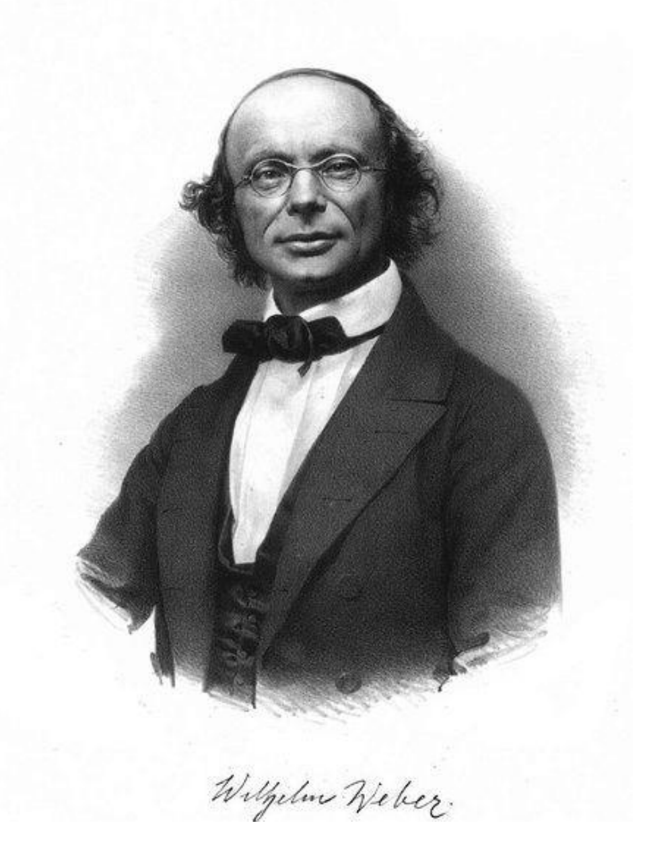

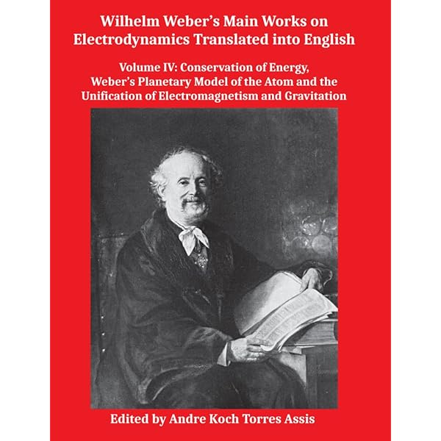
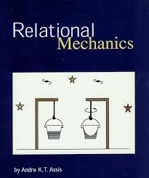
Wilhelm Eduard Weber (1804-1891)
Physicist, esteemed collaborator of Gauss in geomagnetism, telegraphy, and electrodynamics.
Collected works (1892) recently translated into English by Prof. Andre Koch Torres Assis at Institute of Physics, UNICAMP, Brazil.

Slide 3
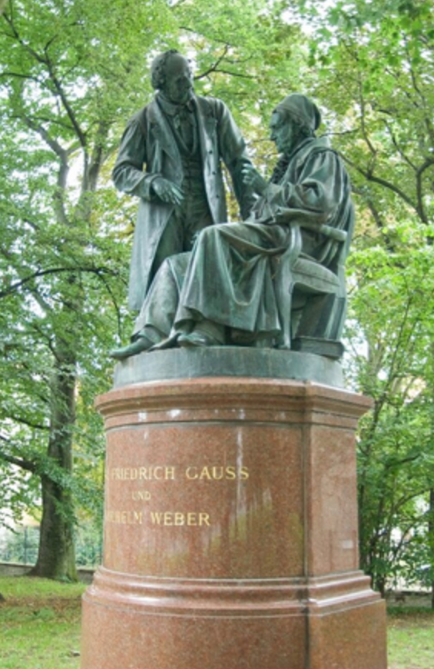
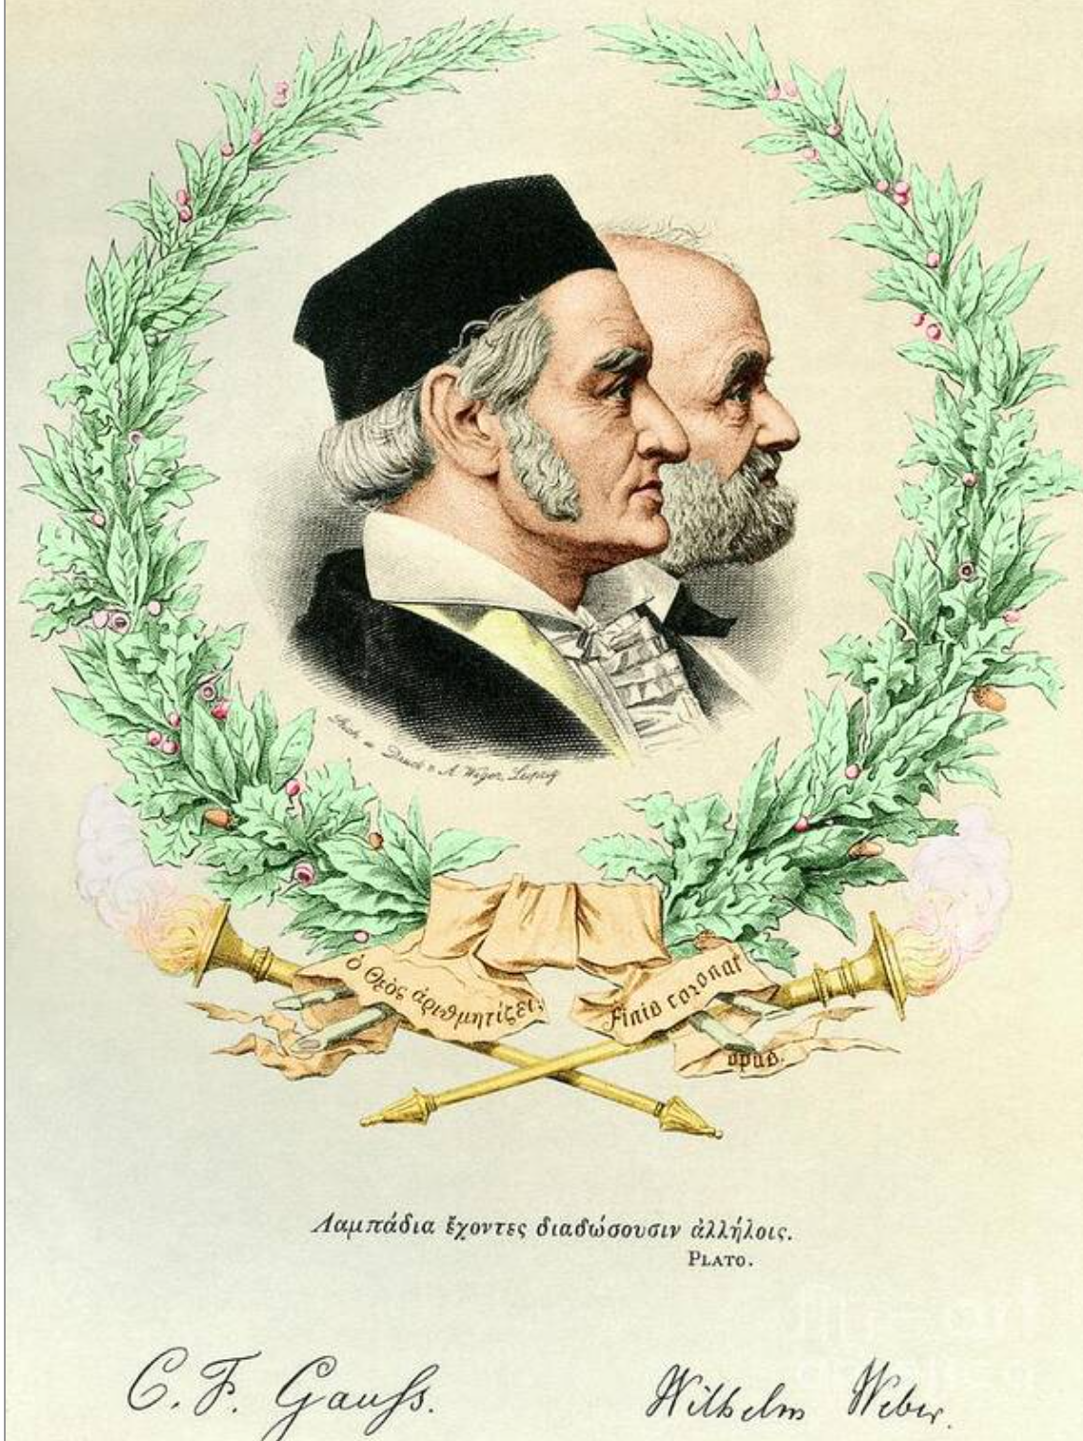

Slide 4
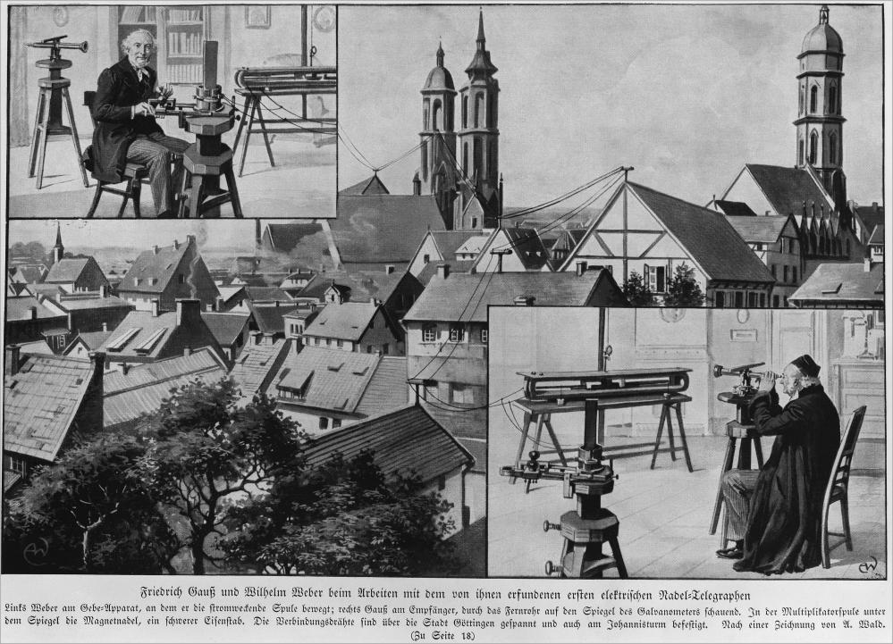
Weber-Kohlrausch constant c [units of velocity]

Slide 5
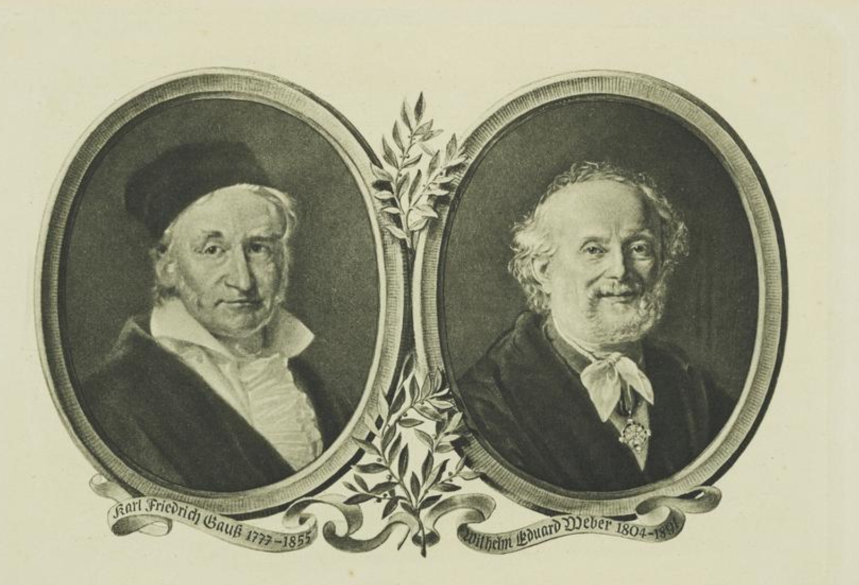
“A curious little fellow …
-Thomas Hirst

Slide 6
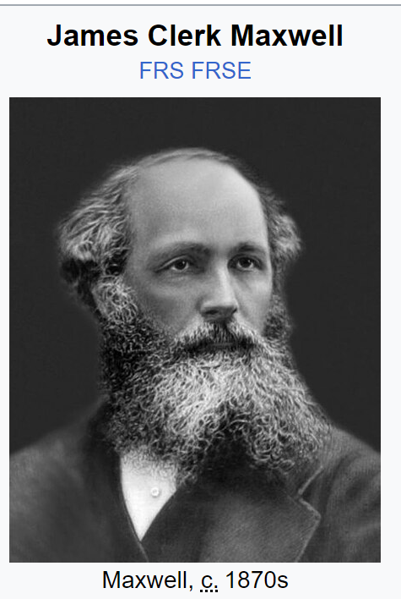
“There exists a professedly physical theory of electrodynamics, which is so elegant, so mathematical, and so entirely different from anything in this [Maxwell’s] paper that I must state it’s axioms, at the risk of repeating what ought to be well known. It is contained in Mr. W.Weber’s Electrodynamic Measurements (1848). [...] Here then is a really physical theory, satisfying the required conditions better perhaps than any yet invented, and put forth by a philosopher [W.Weber] whose experimental researches form an ample foundation for his mathematical investigations”
[Maxwell, 1858, On Faraday’s Lines of Force. ]

Slide 7
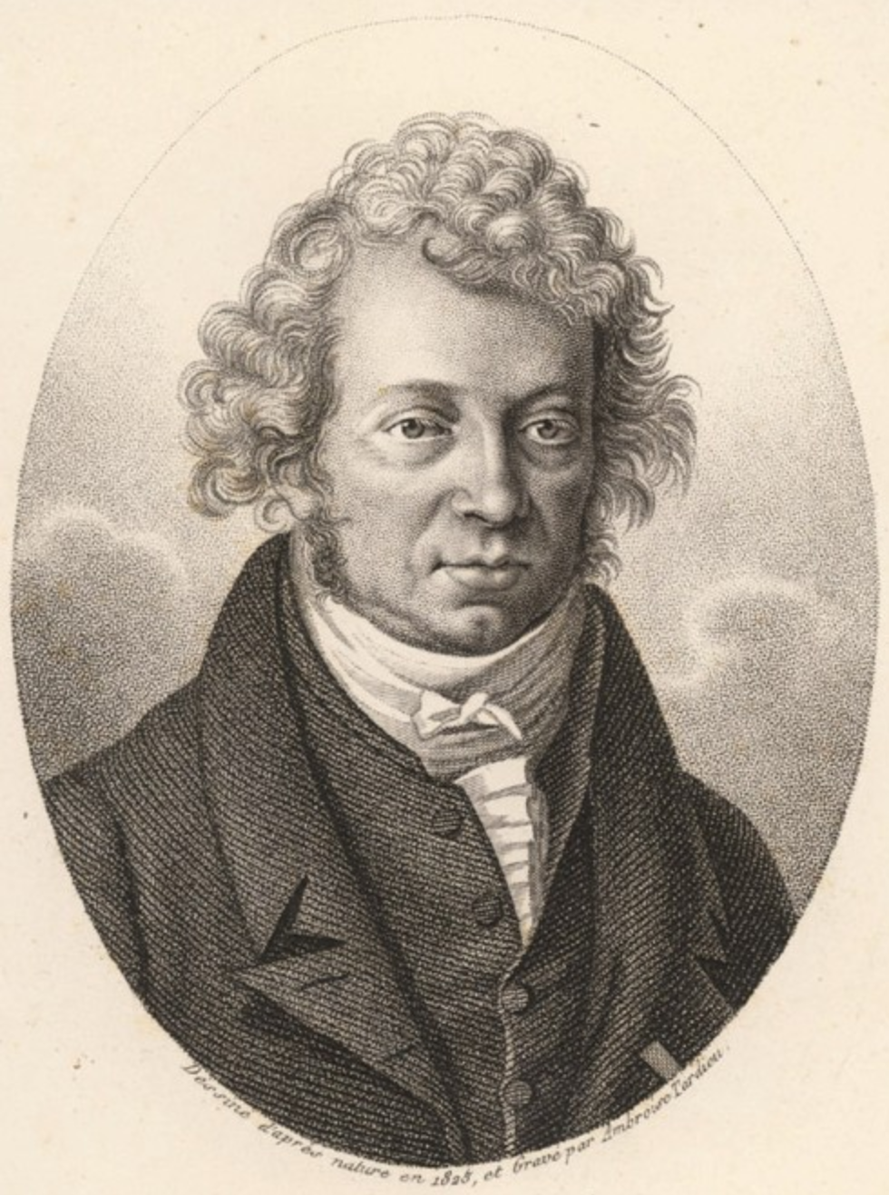
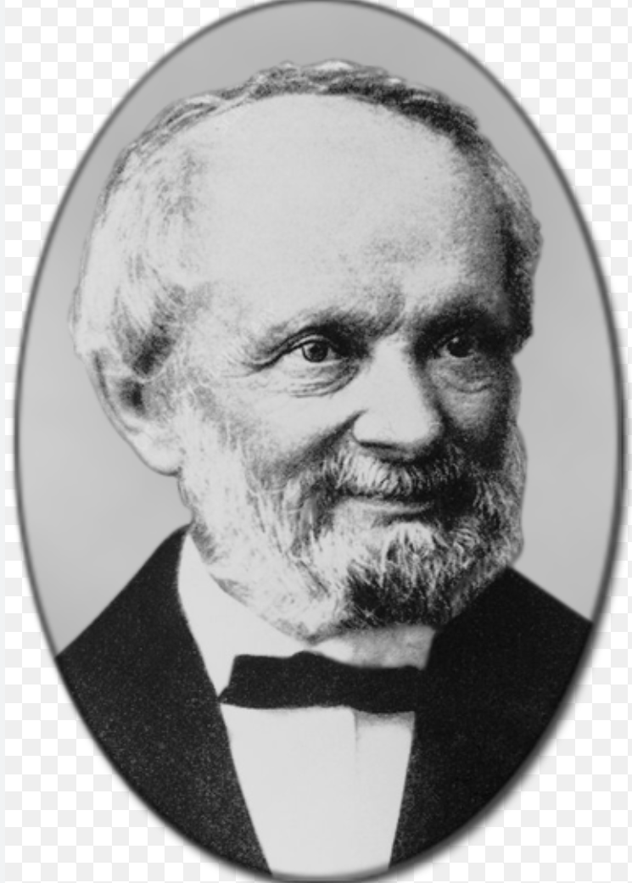
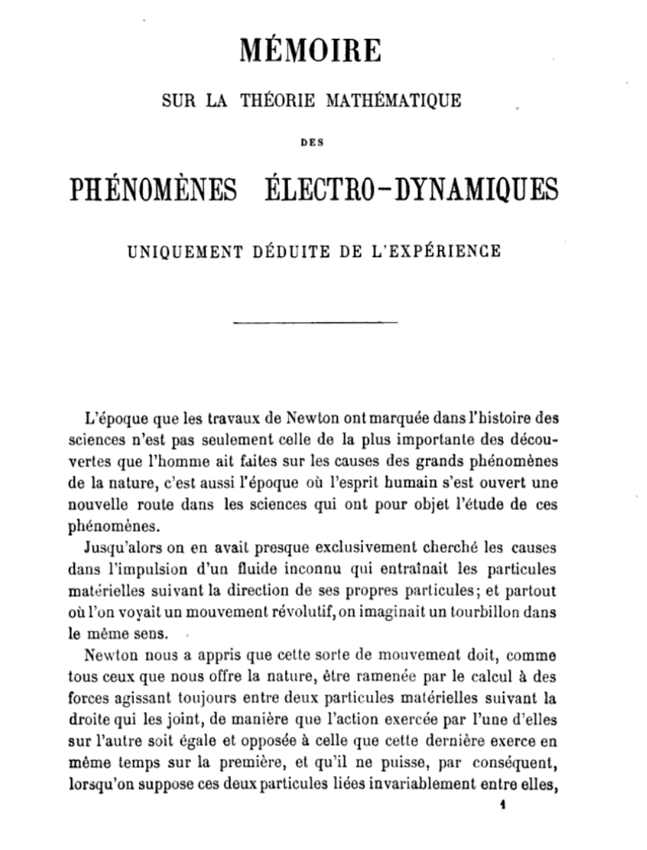
Weber was deeply influenced by Andre-Marie Ampere (1775-1836) investigations and Ampere’s idea that:
the primary interactions of physics are between homogeneous quantities.
e.g. electric charges interacting with electric charges, conductors acting on conductors.
Therefore Weber, following Ampere, looked to unify all physics (mechanics, thermodynamics, chemistry, etc.) from one fundamental force law in electrodynamics.
Notes:
The Hamiltonian of the standard model in physics is not homogenous, but heterogeneous. Compare the Hamiltonian for the hydrogen atom [insert]

Slide 8
Unify all physics with one fundamental electrodynamic force law?

Slide 9
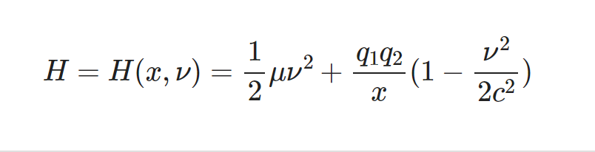
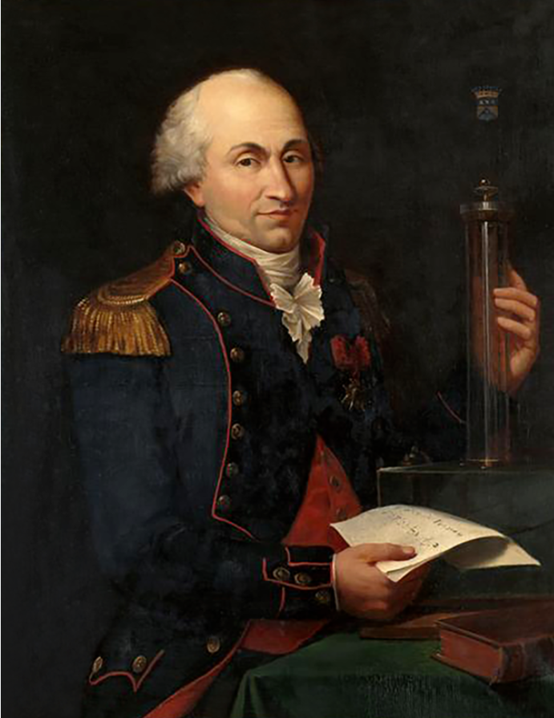
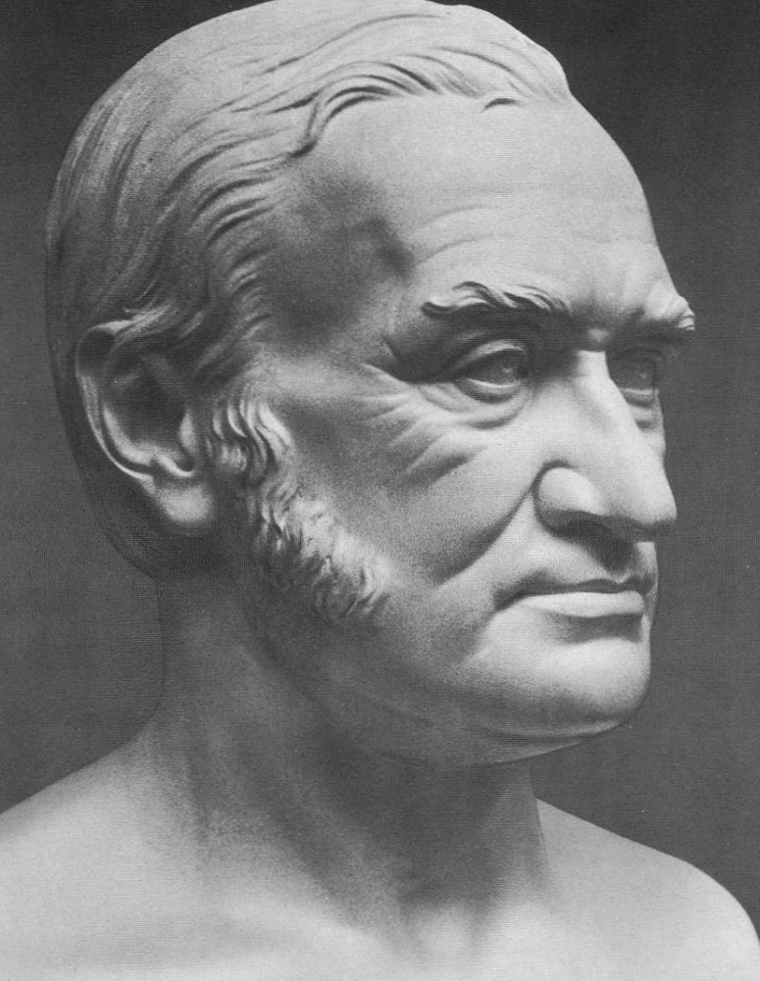
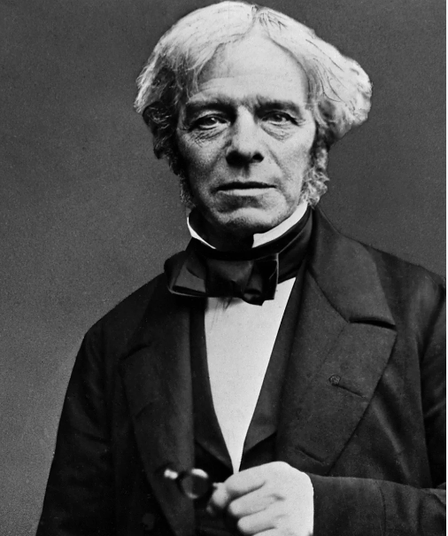
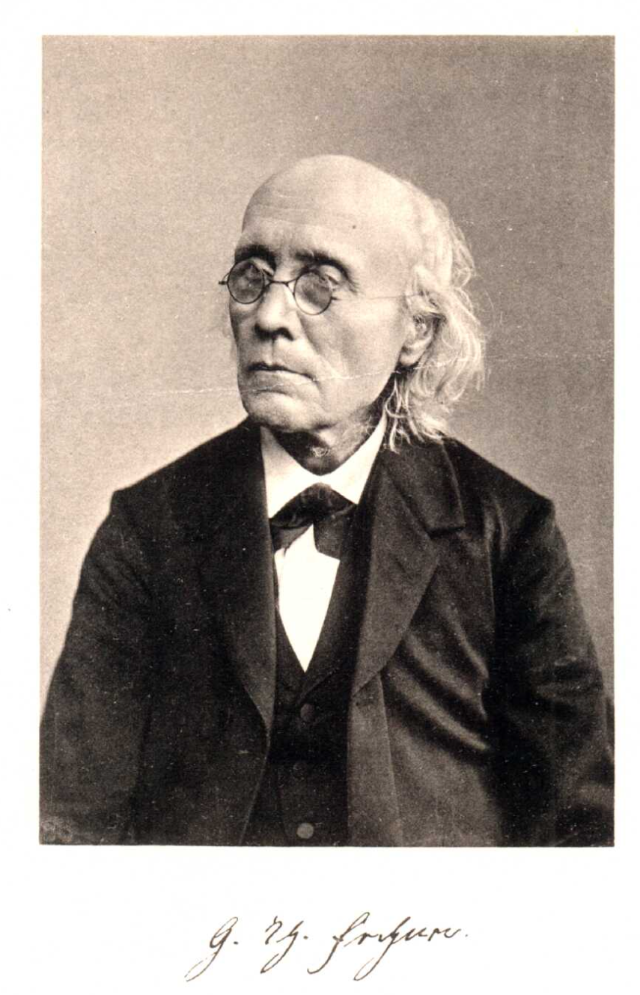

Slide 10
Weber’s Hamiltonian for Two-Body Electrical System

Slide 11
Weber’s Hamiltonian for Two-Body Electrical System
x=r is relative radial distance (scalar)
nu=v is relative radial velocity (scalar)
mu is reduced inertial mass mu=m1m2/(m1+m2) (scalar)
q1, q2 are units of electrical charge (scalar)
c is Weber-Kohlrausch constant units of velocity (scalar)

Slide 12
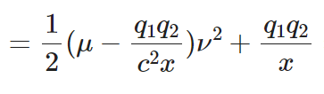
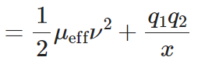
Derivation of Weber’s Effective Inertial Mass for Two-Body System:
Notes:
For two body problem, the definition of effective inertial mass is straightforward, it’s given by a formula in terms of the relative distance x=r.
For N-body problem, the definition requires an interesting lemma which is a form of the basic optimal transport program. We elaborate below.
Need edit the formula. Notice absence of q1q2 in middle equation over 1/x.

Slide 13
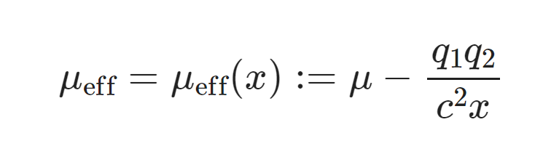

Slide 14
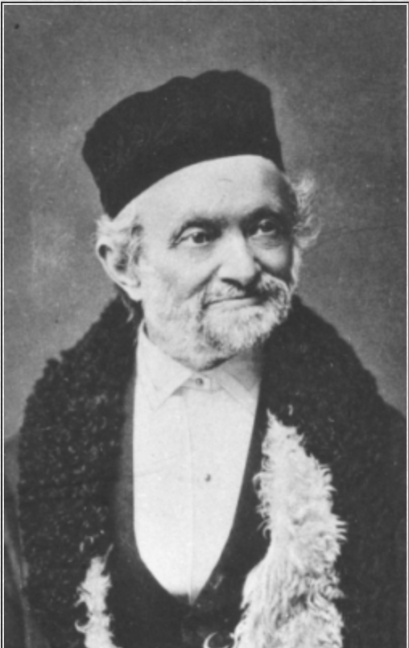
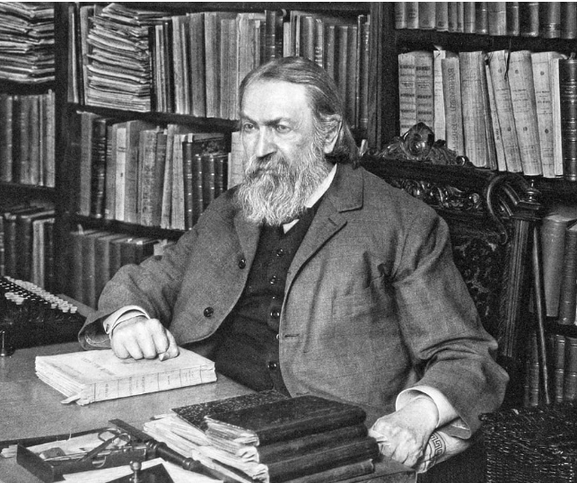
In Weber’s electrodynamics:
Effective inertial mass
is defined canonically
by Conservation of Energy and Hamilton equations.
Notes:
There’s alot more to say, especially with respect to N-body systems, which we ultimately are studying. But it’s important to begin with the two-body problem.

Slide 15
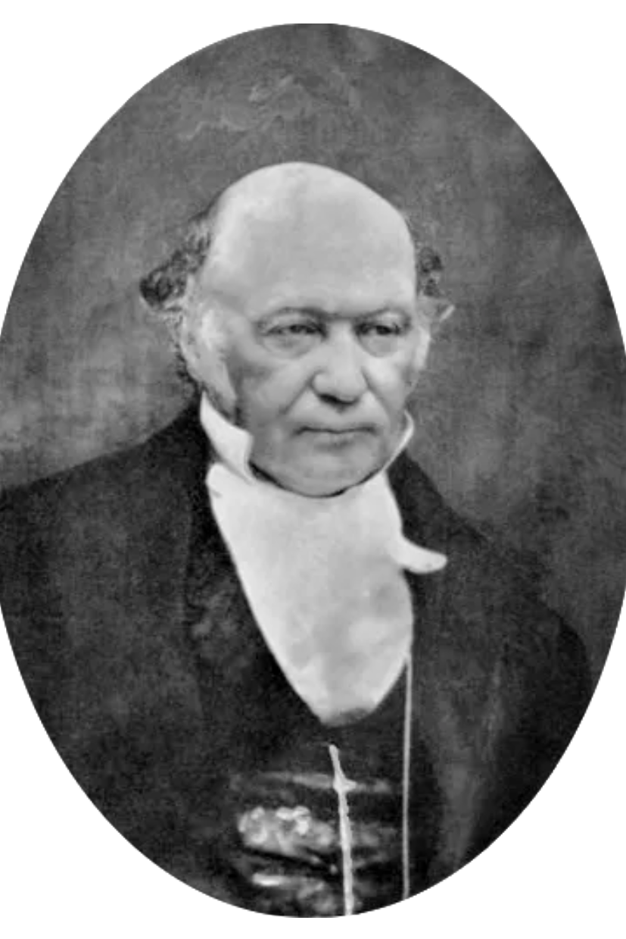
Weber-Hamilton Equations of Motion:
What are the Hamilton Equations?
Notes:
Going too fast. There is an interesting derivation here, especially for N-body problem. For two-body system, everything reduces to a one-dimensional problem and the effective mass is the unique scalar such that Hamilton-Jacobi and CoE are satisfied. For N-body system, this scalar is replaced by a linear transformation (mapping the state variables x’,v’ onto the Hamilton-Jacobi gradients J\nabla H. We have an interesting lemma which says: there exists canonical (minimal L2 energy map) linear transformation A which represents the effective inertial mass of the system. The operator A is symmetric and therefore diagonalizable.
Conservation of Energy is important property since Helmholtz’ erroneous critique of Weber’s force law.

Slide 16
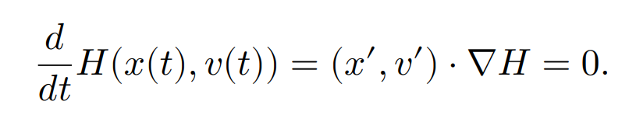
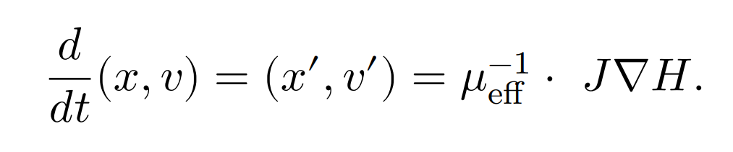
Weber-Hamilton Equations of Motion:
Hamilton Equations: a formalism to obtain equations of motion which satisfy Conservation of Energy (CoE).
Notes:
Going too fast. There is an interesting derivation here, especially for N-body problem. For two-body system, everything reduces to a one-dimensional problem and the effective mass is the unique scalar such that Hamilton-Jacobi and CoE are satisfied. For N-body system, this scalar is replaced by a linear transformation (mapping the state variables x’,v’ onto the Hamilton-Jacobi gradients J\nabla H. We have an interesting lemma which says: there exists canonical (minimal L2 energy map) linear transformation A which represents the effective inertial mass of the system. The operator A is symmetric and therefore diagonalizable.
Conservation of Energy is important property since Helmholtz’ erroneous critique of Weber’s force law.

Slide 17
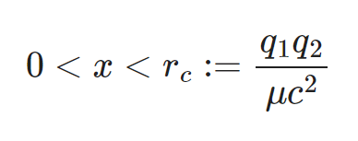
Weber Hamilton Equations of Motion:
q1*q2 > 0 implies effective inertial mass becomes negative(!) at a sufficiently small critical radius.
Notes:
What’s the numerical scale of the critical radius? Reference needed!!!

Slide 18
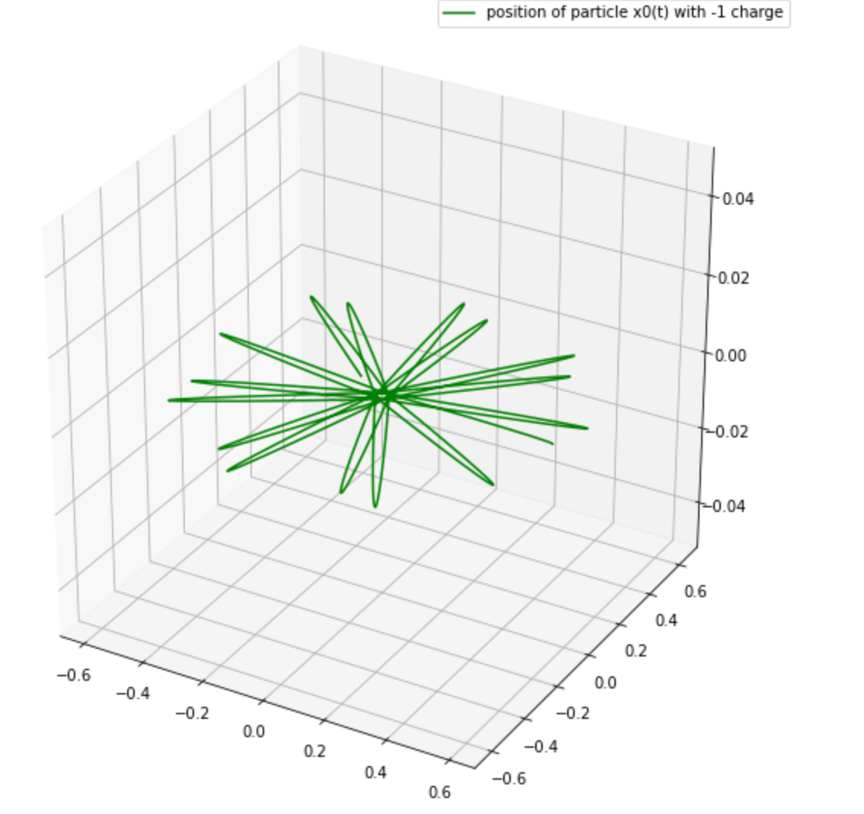
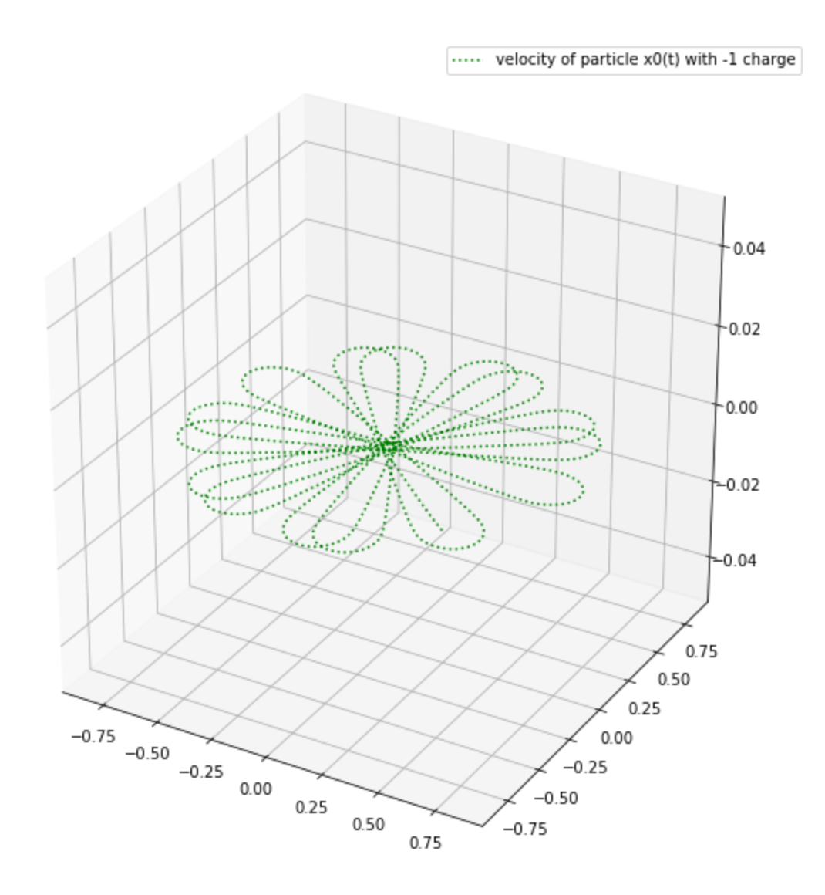
Two-Body Weber-Hamilton satisfies:
Conservation of Energy
Conservation of Angular Momentum
Precession
….

Slide 19
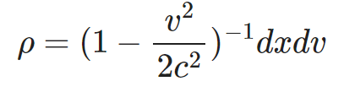
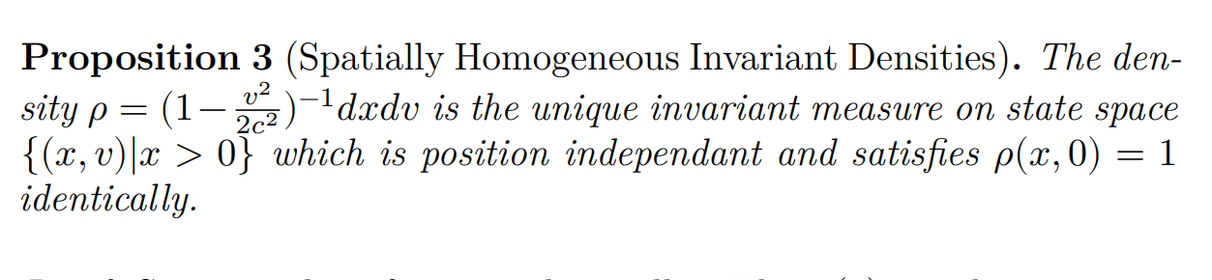
Two-Body Weber-Hamilton and Gibbs-Liouville:

Slide 20
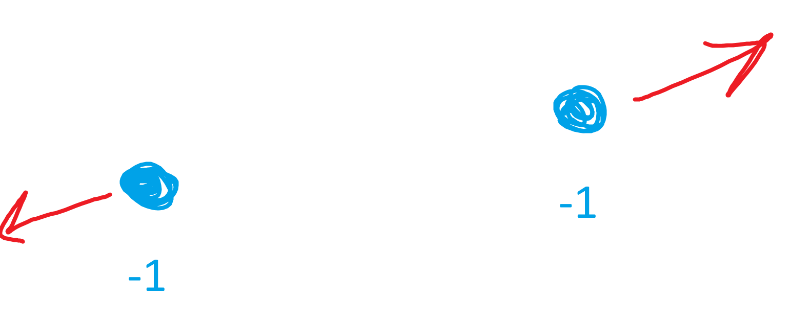
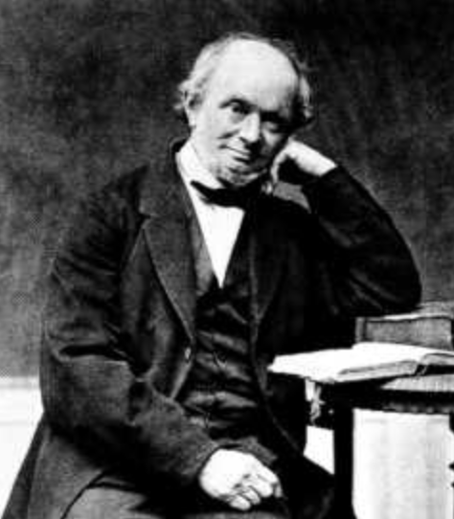
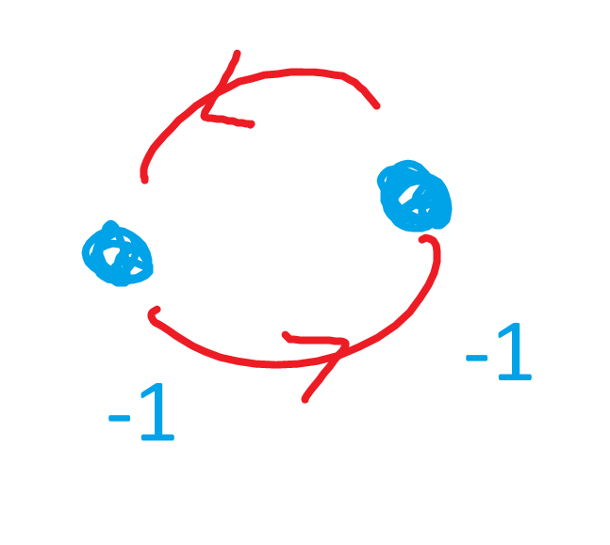
Weber predicts electrons repel at large distances:
and attract at sufficiently small distances ( x < critical radius r_c ) :

Slide 21
When does (-1)+(-1) equal (-2) ?
How much energy is required to assemble
Weber’s (-1,-1)=(-2) molecule?
How much work to drive a pair of identical electrons from r = + ∞ to the critical radius r=r_c?

Slide 22
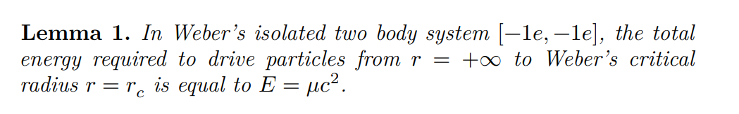
where mu is inertial mass of electron e.

Slide 23
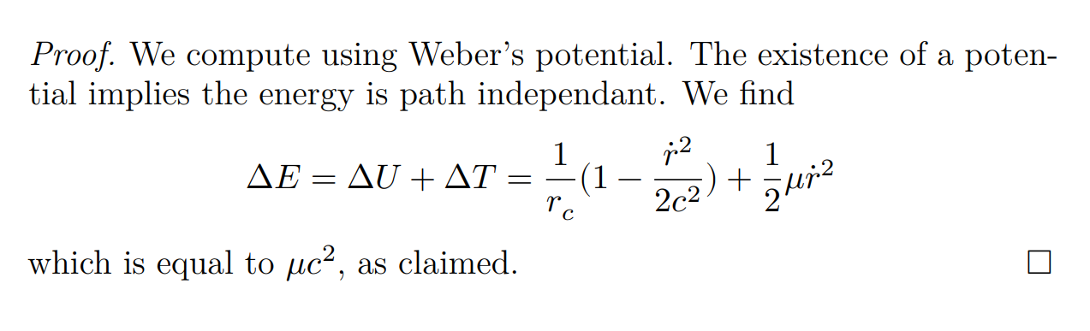

Slide 24
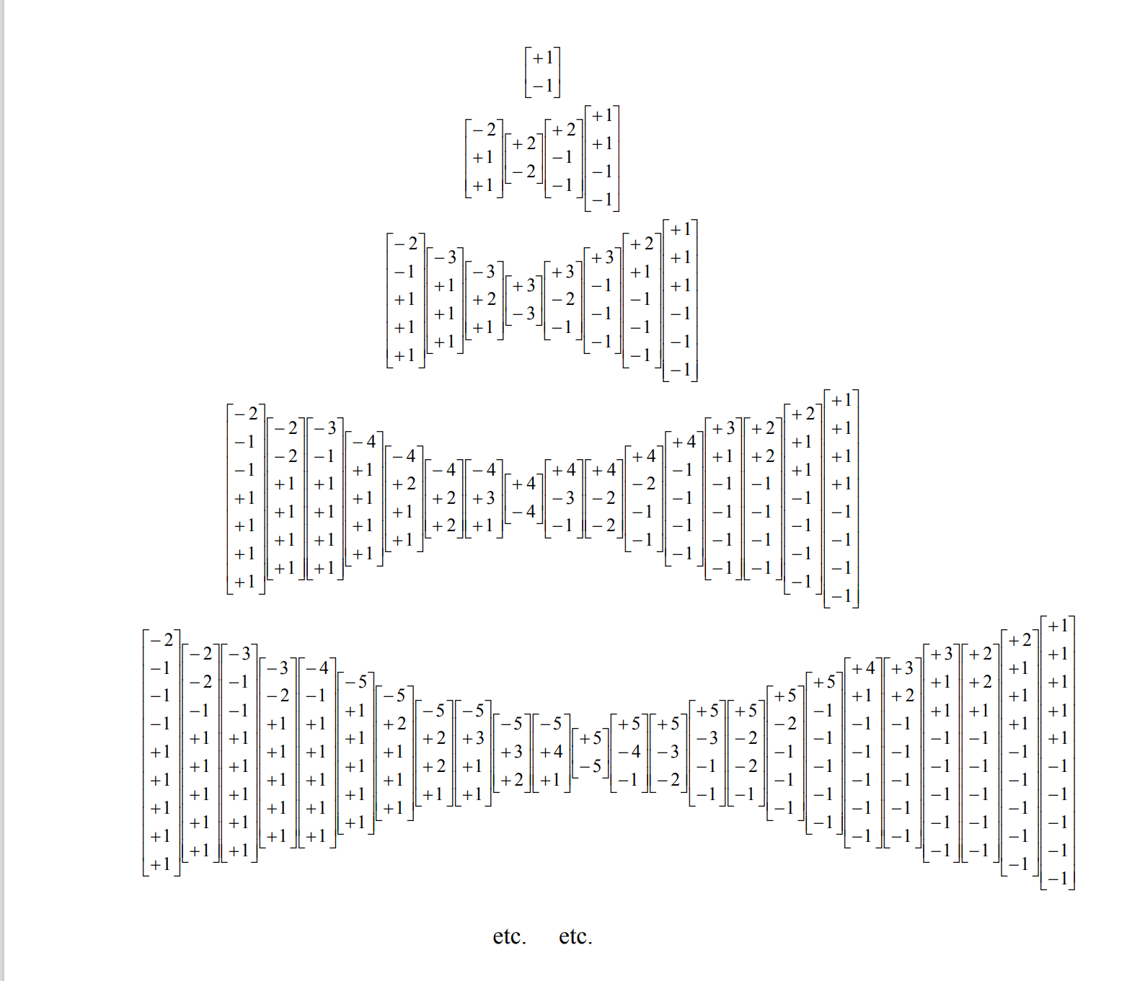
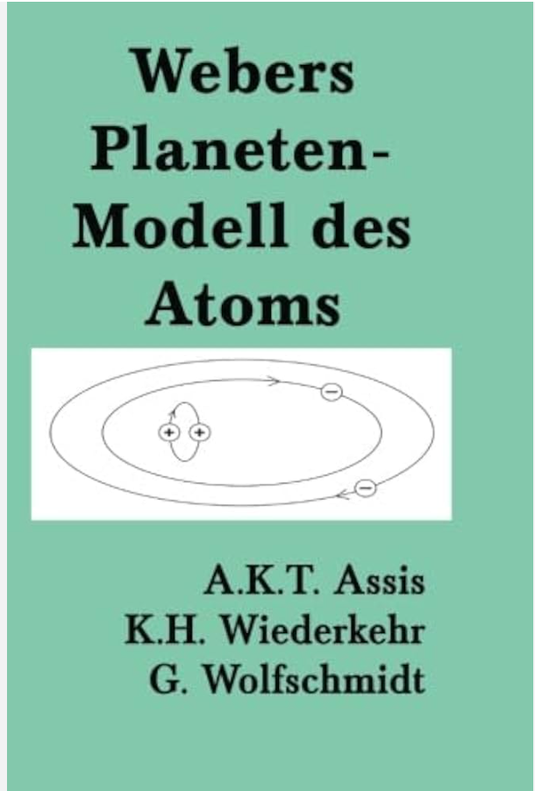
Table from Weber’s final memoir published posthumously (1894).

Slide 25
Weber’s electrodynamics is an instantaneous action-at-a-distance theory, with central radial force law depending on relative position, relative velocity, and relative accelerations.
20th Century dominated by Maxwell-Faraday “field theoretic” viewpoint.
I.e. Faraday “electromagnetism” versus Ampere’s “electrodynamiques”
Helmholtz’ 1847 Erroneous Critique of Weber’s Conservation of Energy, repeated by Kelvin, Tait, eventually corrected and acknowledged by Maxwell in 1872.

Slide 26


Slide 27

Gauss, Riemann, Neumann, etc., all believed that forces ought to propagate with some large finite velocity “c”. Gauss withheld his own personal investigations into electrodynamics because they did not contain this “capstone” result.
Yet Weber’s instantaneous action-at-a-distance theory is compatible with finite propagation of light using Ralph Sansbury’s idea !
Ralph N. Sansbury
(1938-2014)

Slide 28
Ralph N. Sansbury
(1938-2014)

